Slide 1
Artificial Intelligence / Machine learning club!

Slide 2
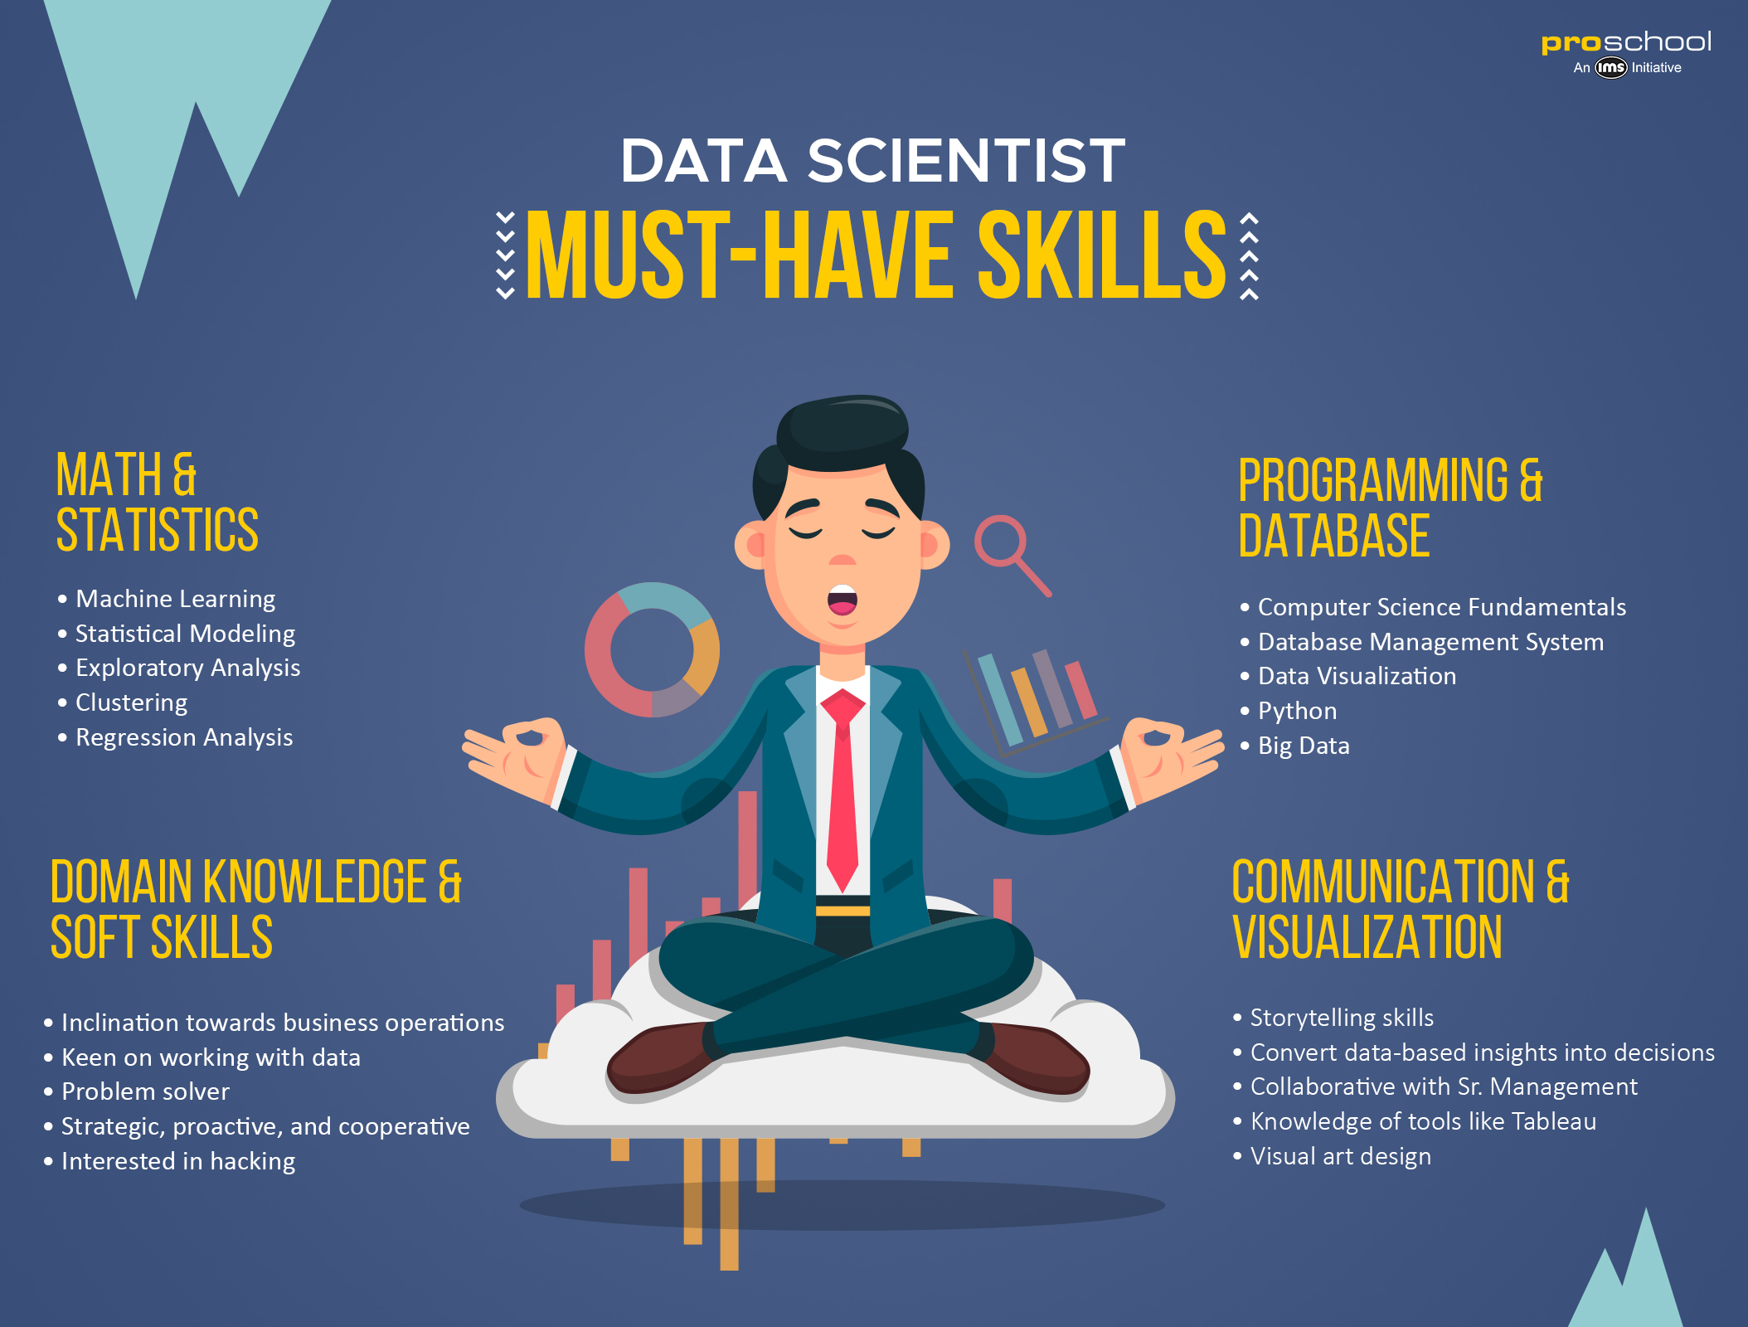
Data science

Slide 3
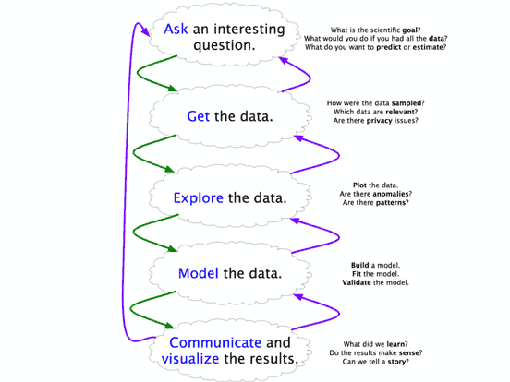

Slide 4
Maths
Ststistics
Probability
Bit ML
Strong coding background - python

Slide 5
Pandas
Power shell – pip install pandas,numpy ; pip install jupyter ; jupyter notebook
Import numpy and pandas
Dictionary – dict1 = { “name”:[‘name1’, ‘name2’, ‘name3’] , “marks”:[12,34,98], “city”:[‘city1’, ‘city2’, ‘city3’]
df = pd.DataFrame(dict1)
df

Slide 6
Execute
df.to_csv(‘name_of_file.csv’)
df.to_csv(‘name_of_file.csv’, index=False)
df.head(2)
df.tail(2)
df.describe()

Slide 7
If u already have a data set, how to read in jupyter
Make csv file
Jupyter- import pandas
Name = pd.read_csv(“filename.csv”)
name

Slide 8
Can access dataframe in any way or edit
Name[‘column’][index value] = new value
Name
Convert back to csv
Change index – name.index = [ values]

Slide 9
Why pandas ,why not excel!?
Open source data analysis library
Cant use functions or tech provided by python
With bython we can analyse manipulate and access data easily
High speed and robust data operations
Excel has data n cell limitations

Slide 10
Data structure in pandas
Series – 1 dimension array, stores single row or data in df ; any one type of data
Data frame – tabular spreadsheet with row can coloum; different type of data

Slide 11
What is jupyter!?
Open source web application
Supports over 40 programming languages
Best of data analysis
Interactive outputs

Slide 12
Series and dataframe
Ser = pd.Series(np.random.rand(34))
type(ser)
Newdf = pd.DataFrame(np.random.rand(334,5),index.arrange(334)
Type(newdf)
Newdf.describe()
Newdf.dtype()

Slide 13
We can access any element in the dataframe with its index
Newdf[row][column]= new value # string
Newdf.type # datatype object
Newdf.index
Newdf.colums
Newdf.to_numpy()

Slide 14
Operations
Newdf.T – Transpose(matrix – row column exchange)
Newdf.sort_index(axis=1,ascending=False)
axis 0 means rows
axis 1 means column
newdf2=newdf # pointer to newdf view like db
Newdf2[0][0] = 87987
Newdf2 = newdf.copy() #makes a copy of newdf not pointer view

Slide 15
Error : settingwithcopwarning
Views share the underlying data with the original DataFrame and thus when you modify a view you may also modify the original object.
Copies are independent (subsets of) replicas of the original DataFrames and therefore, any changes made on a copy it has no effect on the original object.
The message simply warns the users that they are operating on a copy and not the original object itself.
When we do chained assignment(the combination of chained and assignment operations)sometimes there is no guarantee where there will be view return n where copy return because pandas decides it according to its internal memory management ….

Slide 16
solution
Newdf.loc[row,column]=value
Newdf.drop(row) # for coloumn give axis =1
Newdf()
This only changes the copy not the original dataframe
To change original dataframe : newdf=newdf.drop() OR
newdf.drop([column],axis=1,inplace=True)

Slide 17
To set values always use loc or iloc
Newdf.loc[[rows],[columns]]
Newdf.loc[(newdf[column]<condition> )& (newdf[column]<condition> #similar to db query
Newdf.iloc[0,4]
newdf.reset_index
Rest documentation : https://pandas.pydata.org/docs/

Slide 18

Introduction
Machine learning

Slide 19
Origin of machine learning

Slide 20
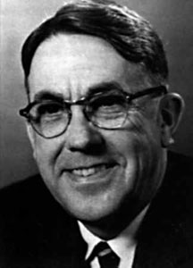
Arthur Samuel coined the word in 1959 “ Machine learning : Field of study that gives computers the ability to learn without being explicitly programmed.”

Slide 21

A computer program that learn from experience E with respect to some task T and some performance measured by P, improves with experience E.

Slide 22

Chess

Slide 23

Suppose your email program watches which emails you do or do not mark as spam and based on that learns how to better filter spam. What is the task T, experience E, and its performance measure P in this setting?

Slide 24
1. Classifying emails as spam or not spam. 2. Watching you label emails as spam or not spam. 3. The number (or fraction) of emails correctly classified as spam/not spam. 4. None of the above—this is not a machine learning problem.

Slide 25

Cat or dog !?

Slide 26


Slide 27



Slide 28

Happy or angry!?

Slide 29


Slide 30
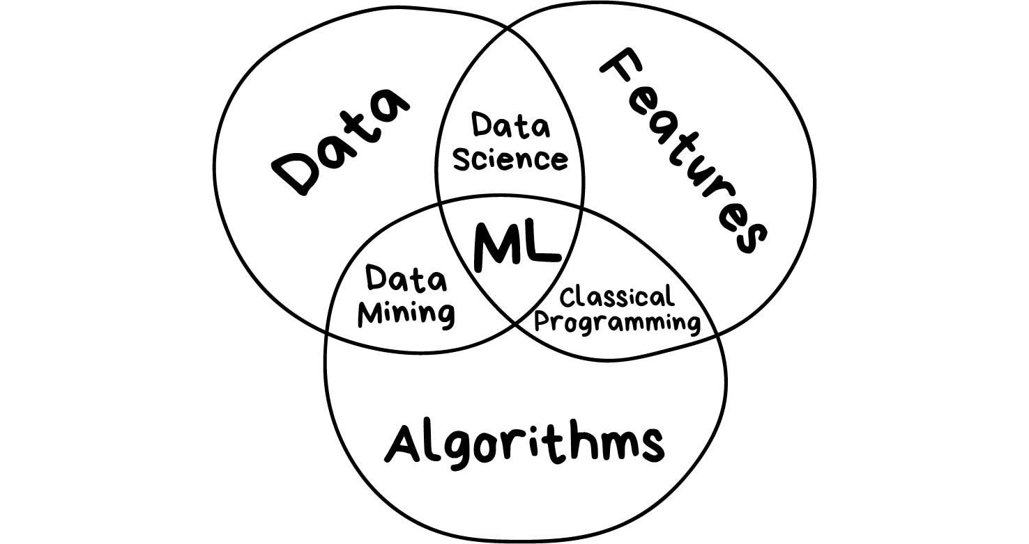

Slide 31
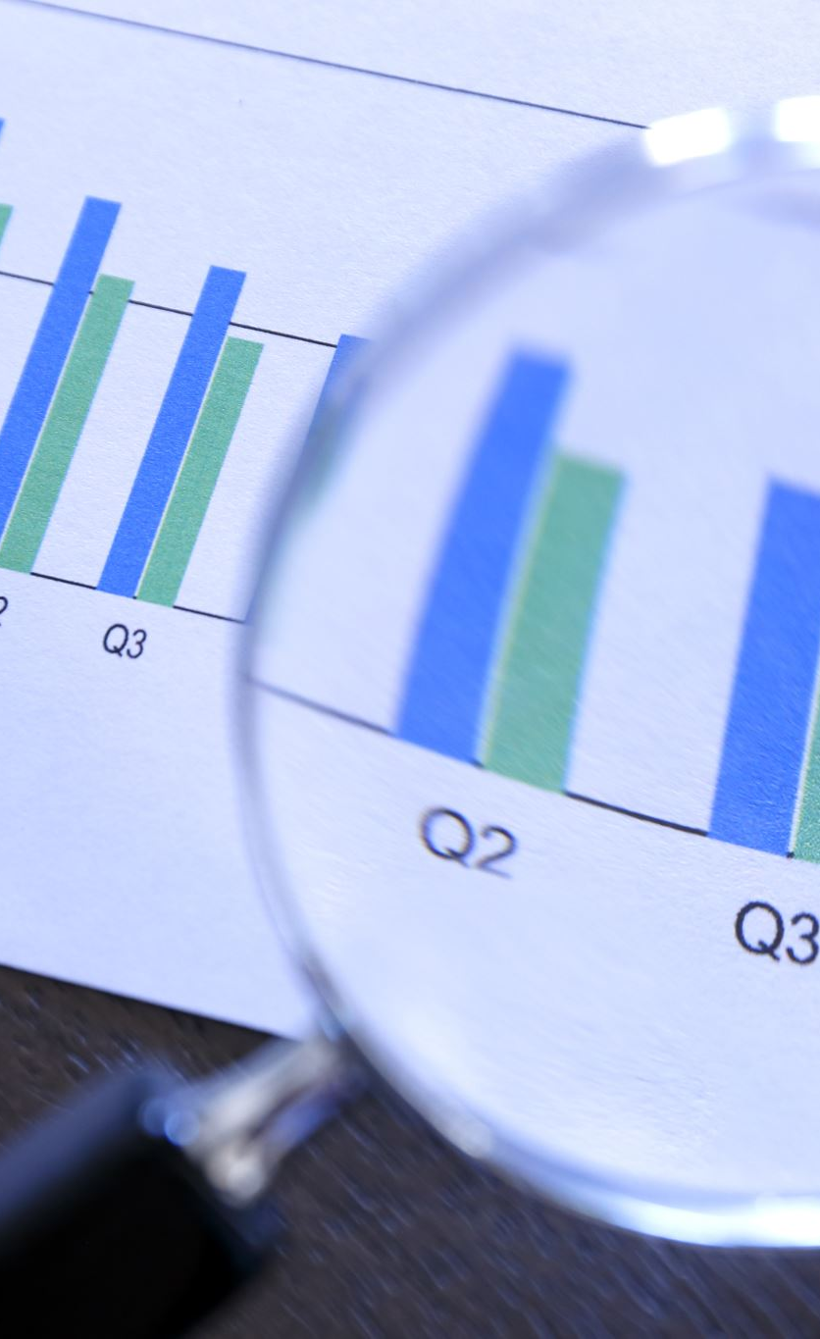
From where to get data !?
From the company
Any investor who is willing to trust u with his data
Online data scraping
UCI ML repository

Slide 32


Slide 33
Classical Machine Learning
Supervised learning
Unsupervised learing

Slide 34
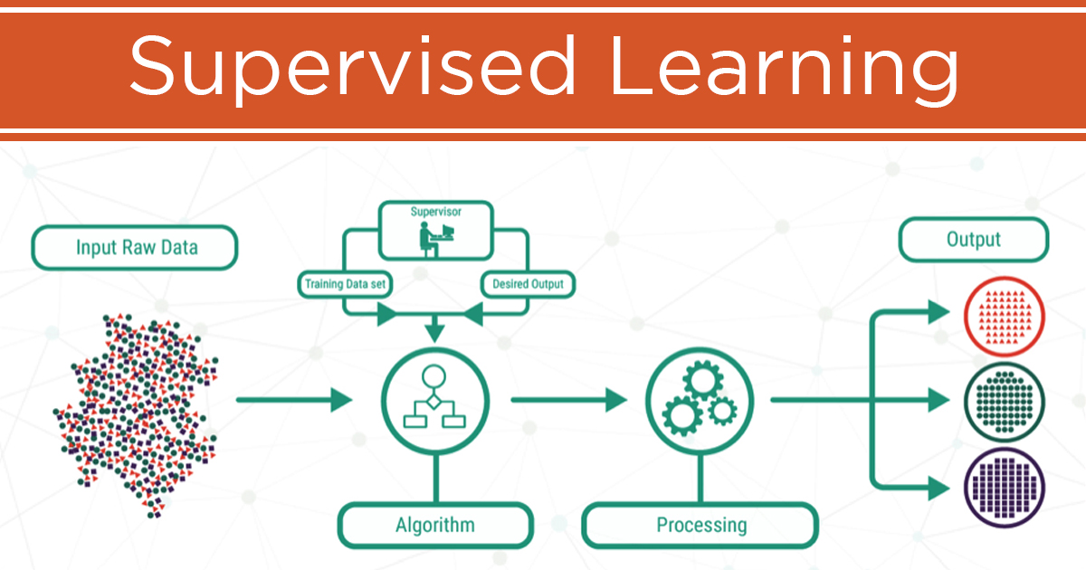

Slide 35
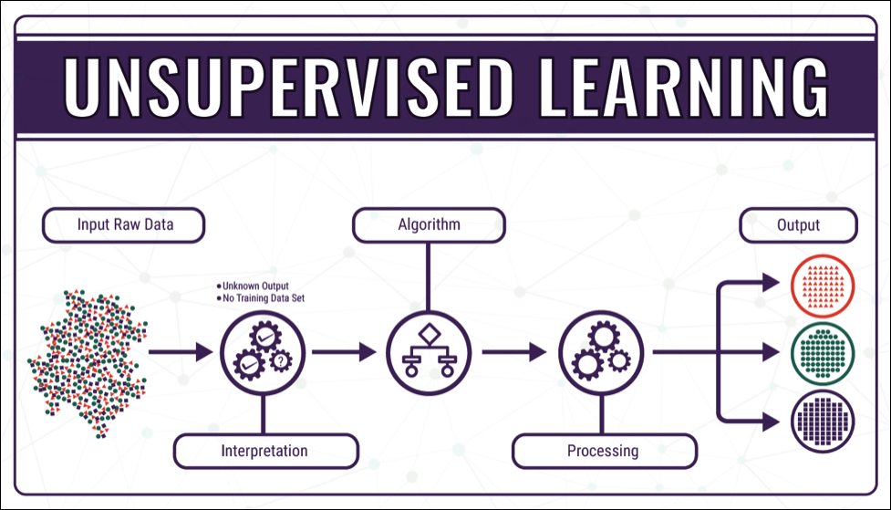
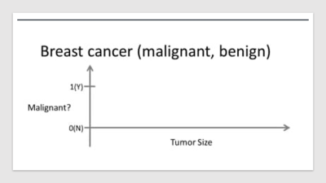
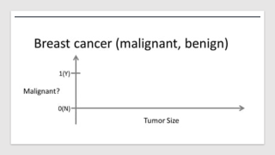

Slide 36
Classification
Splits objects based on attributes known beforehand.
- Separate socks by based on color
- documents based on language
- music by genre

Slide 37
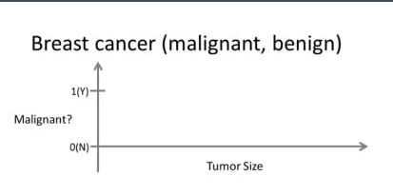

Slide 38
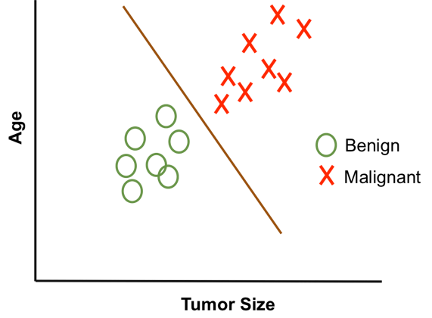

Slide 39
Use:
– Spam filtering – Language detection – A search of similar documents – Sentiment analysis – Recognition of handwritten characters and numbers – Fraud detection

Slide 40

Popular algorithm
Naive bayes
Decision Tree
Logistic Regression
K-Nearest Neighbors
Support Vector Machine

Slide 41
Regression
Model to predict a continuous valued output
Regression is basically classification where we forecast a number instead of category.
car price by its mileage
traffic by time of the day

Slide 42
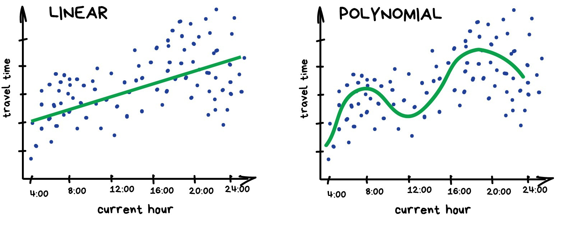
Predicting traffic jam

Slide 43
Use
Stock price forecasts
Demand and sales volume analysis
Medical diagnosis
Any number-time correlations

Slide 44
Popular algorithm
Linear regression
Polynomial regression
Ridge regression

Slide 45
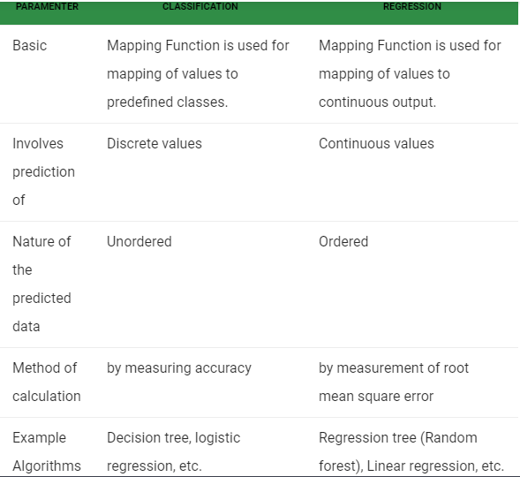
Comparison between classification and regression

Slide 46
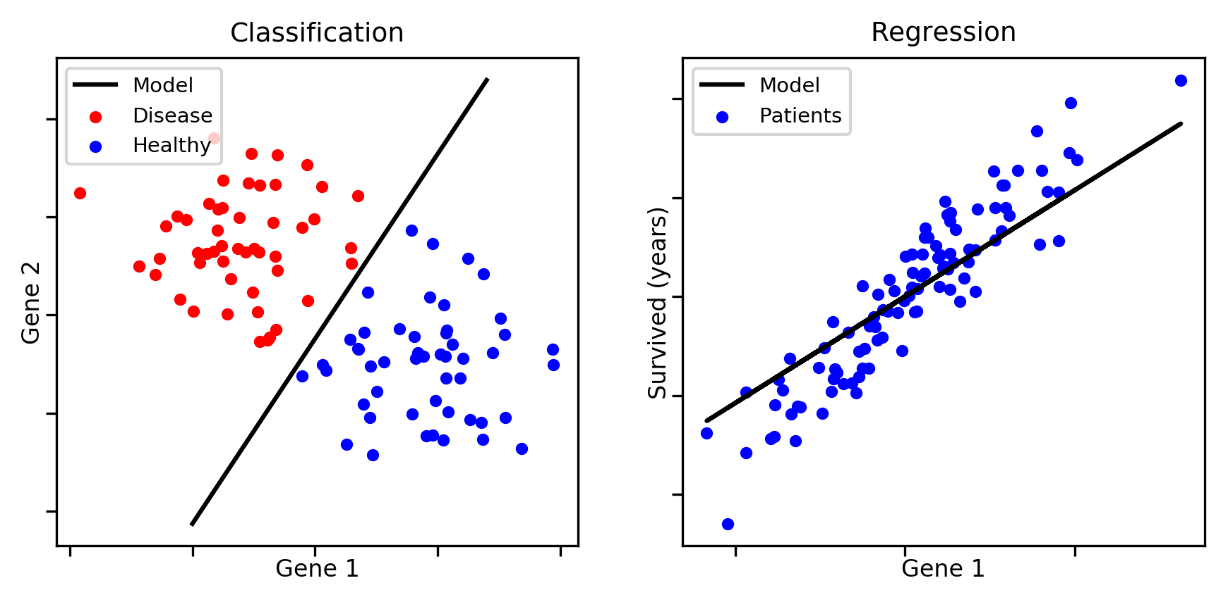

Slide 47

Problem 1: You have a large inventory of identical items. You want to predict how many of these items will sell over the next 3 months. Problem 2: You’d like software to examine individual customer accounts, and for each account decide if it has been hacked/compromised.

Slide 48
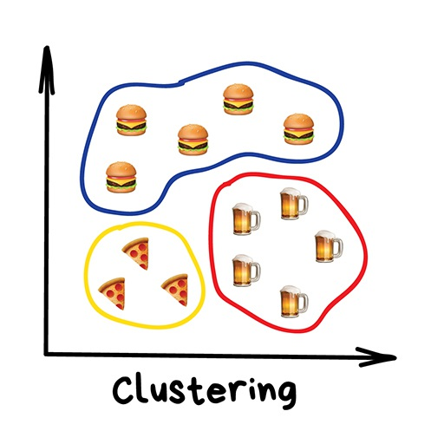
Clustering
Divides objects based on unknown features.

Slide 50
Use
For market segmentation (types of customers, loyalty)
To merge close points on a map
For image compression
To analyze and label new data
To detect abnormal behavior

Slide 51
Popular algorithm
K-means clustering
Mean-Shift
DBSCAN

Slide 52
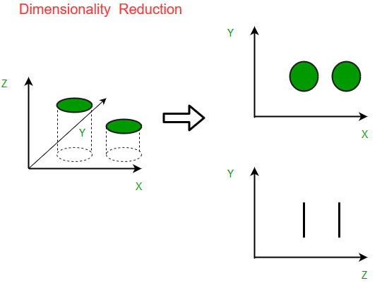
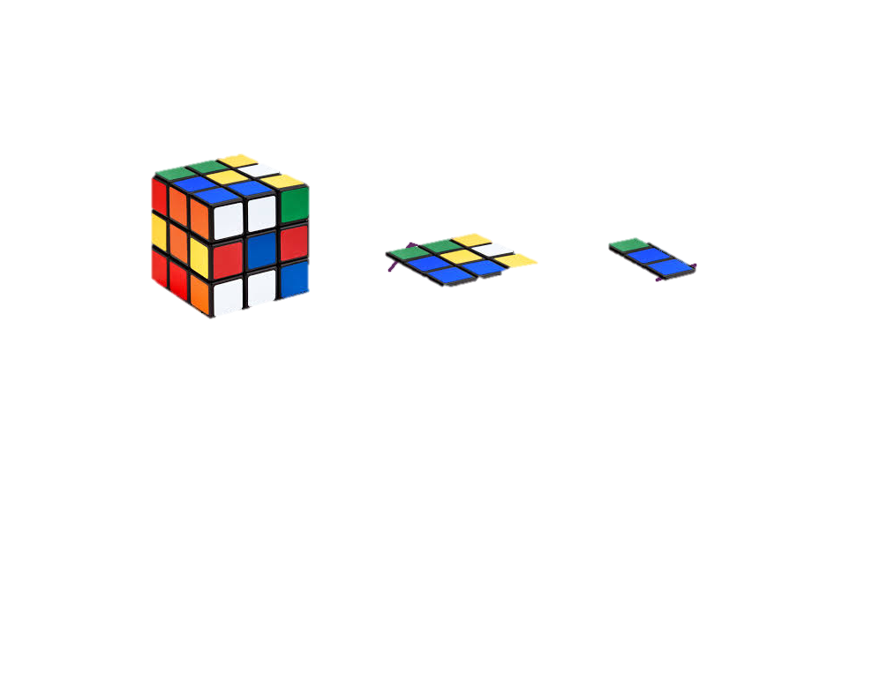
Dimensionality reduction (generalization)
It is used to reduce the number of input variables in a dataset.

Slide 53
Use
Recommender systems (★)
Beautiful visualizations
Topic modeling and similar document search
Fake image analysis
Risk management

Slide 54
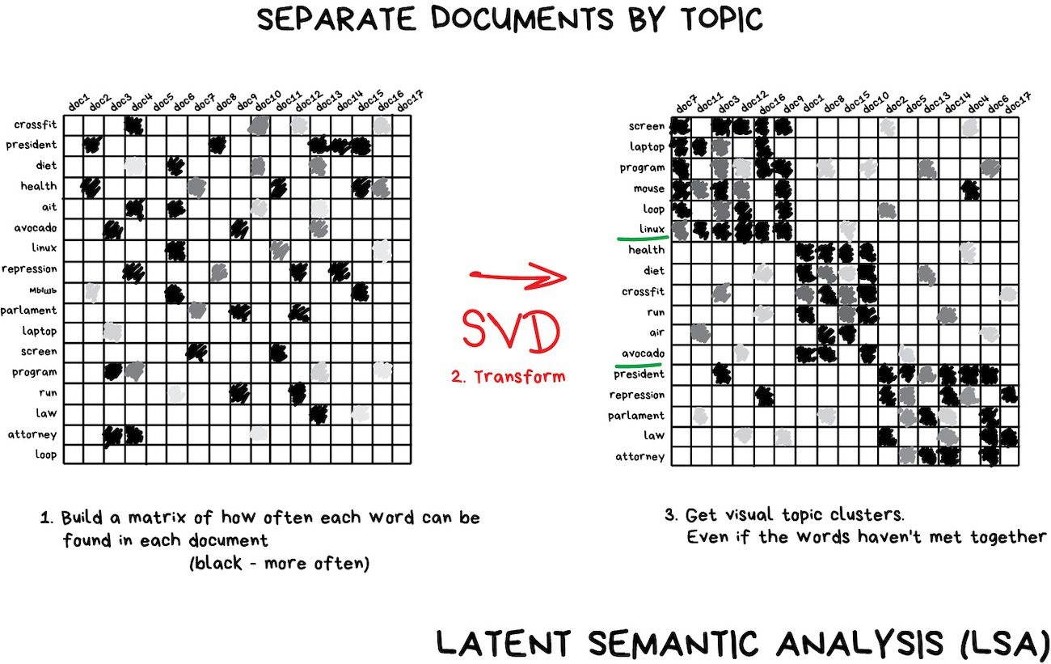

Slide 55
Popular algorithm
Principal Component Analysis(PCA)
Singular Value Decomposition(SVD)
Latent Dirichlet allocation(LDA)
Latent Semantic Analysis (LSA, pLSA, GLSA)
t-SNE (for visualization)

Slide 56
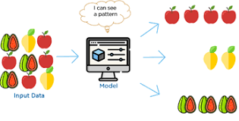
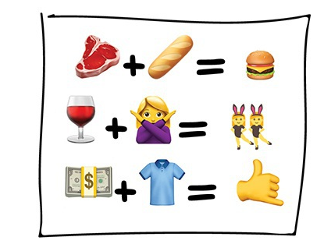
Association rule learning
A data mining tequnie to find relation or patter between the variables or features in the dataset

Slide 57
Use
To forecast sales and discounts
To analyze goods bought together
To place the products on the shelves
To analyze web surfing patterns

Slide 58
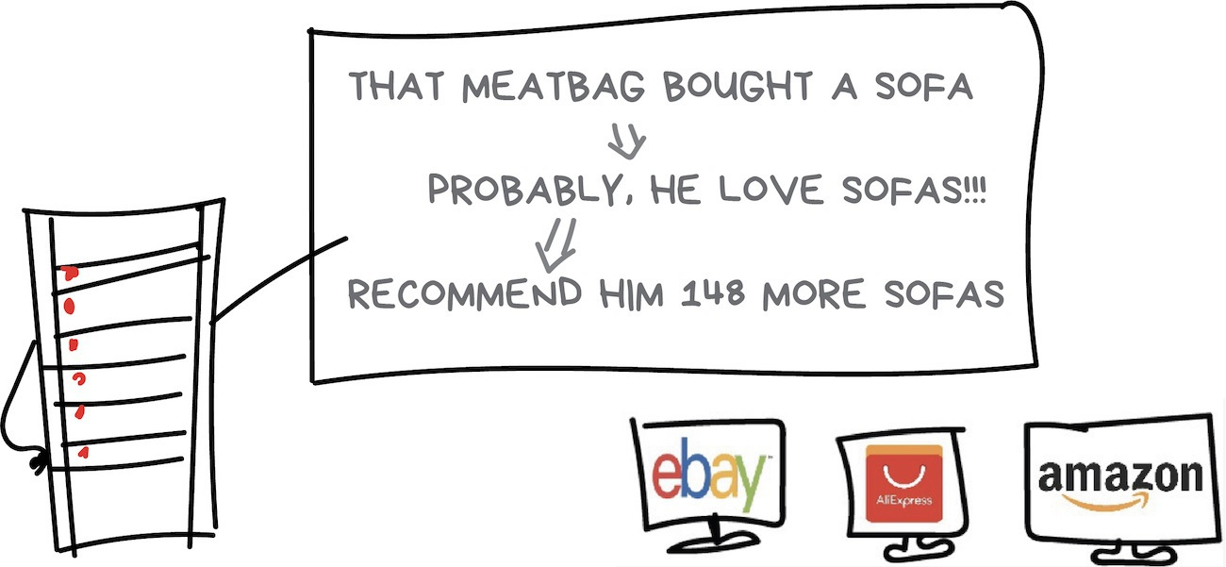

Slide 59
Popular algorithm
Apriori
Euclat
FP-growth

Slide 60
Thank you

